Slide 1

Subject: FUNDAMENTALS Of iOS APPLICATION DEVELOPMENT WITH SWIFT
Module Number - 5
Module Name: Navigation & Workflows

Slide 2
Navigation & Workflows
Syllabus
Enumerations
Protocols
NavigationController
Segues
Tab Bar Controller
ViewController Life Cycle
App Anatomy Life Cycle
Model View Controller Design Pattern
Prototype & Project Planning

Slide 3
Navigation & Workflows
AIM:
To understand the concept’s of NavigationController. Swift Concepts, Segues, TabBar Controller, App Life Cycle, Prottyping & Project planning.

Slide 4
Navigation & Workflows
Objectives:
Study and understand the swift concepts
Study and understand the Navigation Controller & Segues
Study and understand the concepts of Tab Bar Controller

Slide 5
Navigation & Workflows
Table of Contents:
Enumerations
Protocols
NavigationController
Segues
Tab Bar Controller
ViewController Life Cycle
App Anatomy Life Cycle
Model View Controller Design Pattern
Prototype & Project Planning

Slide 6
ENUMERATIONS
Navigation & Workflows
An enumeration defines a common type for a group of related values and enables you to work with those values in a type-safe way within your code.
If you are familiar with C, you will know that C enumerations assign related names to a set of integer values. Enumerations in Swift are much more flexible, and don’t have to provide a value for each case of the enumeration.
If a value (known as a raw value) is provided for each enumeration case, the value can be a string, a character, or a value of any integer or floating-point type.
Alternatively, enumeration cases can specify associated values of any type to be stored along with each different case value, much as unions or variants do in other languages. You can define a common set of related cases as part of one enumeration, each of which has a different set of values of appropriate types associated with it.

Slide 7
Navigation & Workflows
Enumerations in Swift are first-class types in their own right. They adopt many features traditionally supported only by classes, such as computed properties to provide additional information about the enumeration’s current value, and instance methods to provide functionality related to the values the enumeration represents. Enumerations can also define initializers to provide an initial case value; can be extended to expand their functionality beyond their original implementation; and can conform to protocols to provide standard functionality.
Enumeration Syntax
enum SomeEnumeration {
// enumeration definition goes here
}

Slide 8
Navigation & Workflows
Here’s an example for the four main points of a compass:
enum CompassPoint {
case north
case south
case east
case west
}
The values defined in an enumeration (such as north, south, east, and west) are its enumeration cases. You use the case keyword to introduce new enumeration cases.
NOTE
Swift enumeration cases don’t have an integer value set by default, unlike languages like C and Objective-C. In the CompassPoint example above, north, south, east and west don’t implicitly equal 0, 1, 2 and 3. Instead, the different enumeration cases are values in their own right, with an explicitly defined type of CompassPoint.

Slide 9
Navigation & Workflows
Multiple cases can appear on a single line, separated by commas:
enum Planet {
case mercury, venus, earth, mars, jupiter, saturn, uranus, neptune
}
Each enumeration definition defines a new type. Like other types in Swift, their names (such as CompassPoint and Planet) start with a capital letter. Give enumeration types singular rather than plural names, so that they read as self-evident:
var directionToHead = CompassPoint.west
The type of directionToHead is inferred when it’s initialized with one of the possible values of CompassPoint. Once directionToHead is declared as a CompassPoint, you can set it to a different CompassPoint value using a shorter dot syntax:
directionToHead = .east

Slide 10
Navigation & Workflows
The type of directionToHead is already known, and so you can drop the type when setting its value. This makes for highly readable code when working with explicitly typed enumeration values.
Matching Enumeration Values with a Switch Statement
You can match individual enumeration values with a switch statement:
directionToHead = .south
switch directionToHead {
case .north:
print("Lots of planets have a north")
case .south:
print("Watch out for penguins")
case .east:
print("Where the sun rises")
case .west:
print("Where the skies are blue")
}
// Prints "Watch out for penguins”

Slide 11
Navigation & Workflows
You can read this code as:
“Consider the value of directionToHead. In the case where it equals .north, print "Lots of planets have a north". In the case where it equals .south, print "Watch out for penguins".” …and so on.
As described in Control Flow, a switch statement must be exhaustive when considering an enumeration’s cases. If the case for .west is omitted, this code doesn’t compile, because it doesn’t consider the complete list of CompassPoint cases. Requiring exhaustiveness ensures that enumeration cases aren’t accidentally omitted.
When it isn’t appropriate to provide a case for every enumeration case, you can provide a default case to cover any cases that aren’t addressed explicitly:
let somePlanet = Planet.earth
switch somePlanet {
case .earth:
print("Mostly harmless")
default:
print("Not a safe place for humans”)
}
// Prints "Mostly harmless”

Slide 12
Protocols & Delegate
Navigation & Workflows
In Swift, a protocol declares a programmatic interface that any class can choose to implement.A protocol declares a set of methods, and an adopting class may choose to implement one or more of its declared methods.
The class that defines the protocol is expected to call the methods in the protocols that are implemented by the adopting class.
class --> protocol name ---> methods (Optional)
Steps for How to find a Class is having Protocol Or Not
Select any Swift Class
Right click and select Jump to Definition
Press Command - F, will see the Search Bar
Type Protocol in search bar, then will show the search results i.e Protocol Name & Optional Methods(pre-defined Methods)

Slide 13
Navigation & Workflows
Eg: If A is a class name and UIViewController is sub class Of
import UIKit
class A: UIViewController, UITextFieldDelegate {
var t1: UITextField!
override func viewDidLoad() {
super.viewDidLoad()
// Do any additional setup after loading the view.
}
//UITextFieldDelegate protocol methods implementation here
}
Note: To conform to more than one delegate, separate the protocols with commas, such as UITextFieldDelegate, UITableViewDataSource
class A: UIViewController, UITextFieldDelegate, UITableViewDelate

Slide 14
Navigation & Workflows
Delegate
In swift, a delegate is just an object that has been assigned by another object as the object responsible for handling events.
Eg: If A is a class name and UIViewController is sub class Of
import UIKit
class A: UIViewController, UITextFieldDelegate {
var t1: UITextField!
var t2: UITextField!
var t3: UITextField!
override func viewDidLoad() {
super.viewDidLoad()
// Do any additional setup after loading the view.
t1 = UITextField()
t1.delegate = self
t2 = UITextField()
t2.delegate = self
t3 = UITextField()
t3.delegate = nil
}
//UITextFieldDelegate protocol methods implementation here
}

Slide 15
Navigation & Workflows
The initializer of the UITextField class includes a parameter called the delegate. Setting this parameter to self means that the current object is responsible for handling all the events fired by this instance of the UITextField class.
If you don’t need to handle events fired by this instance, you can simply set it to nil
t1.delegate = nil
t2.delegate = nil
t3.delegate = nil

Slide 16
NavigationController & Segues
Navigation & Workflows
Class
UINavigationController
A container view controller that defines a stack-based scheme for navigating hierarchical content.
Overview
A navigation controller is a container view controller that manages one or more child view controllers in a navigation interface. In this type of interface, only one child view controller is visible at a time. Selecting an item in the view controller pushes a new view controller onscreen using an animation, thereby hiding the previous view controller. Tapping the back button in the navigation bar at the top of the interface removes the top view controller, thereby revealing the view controller underneath.

Slide 17
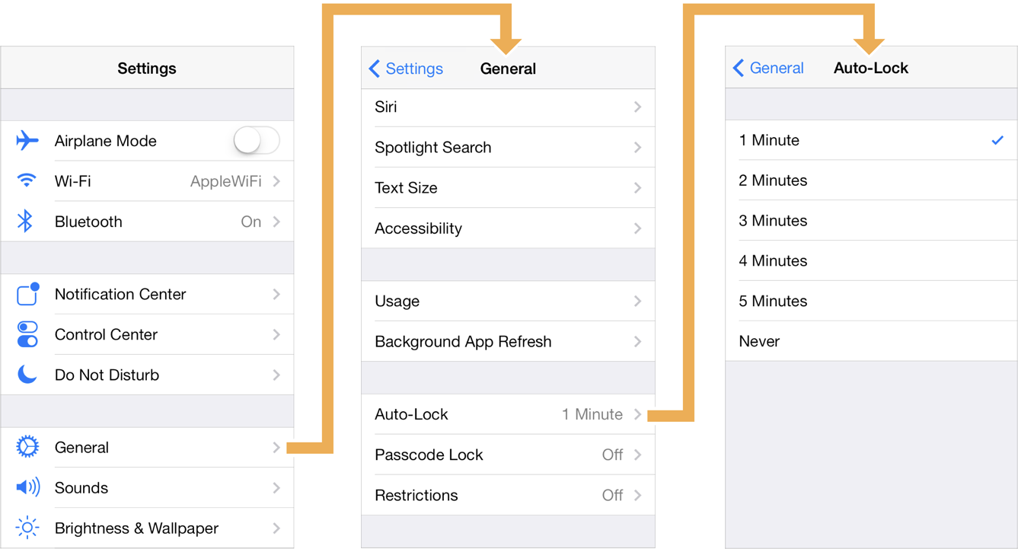
Navigation & Workflows
Use a navigation interface to mimic the organization of hierarchical data managed by your app. At each level of the hierarchy, you provide an appropriate screen (managed by a custom view controller) to display the content at that level. Figure 1 shows an example of the navigation interface presented by the Settings application in iOS Simulator. The first screen presents the user with the list of applications that contain preferences.
Selecting an application reveals individual settings and groups of settings for that application. Selecting a group yields more settings and so on. For all but the root view, the navigation controller provides a back button to allow the user to move back up the hierarchy.
Figure 1 A sample navigation interface

Slide 18
Navigation & Workflows
A navigation controller object manages its child view controllers using an ordered array, known as the navigation stack. The first view controller in the array is the root view controller and represents the bottom of the stack. The last view controller in the array is the topmost item on the stack, and represents the view controller currently being displayed. You add and remove view controllers from the stack using segues or using the methods of this class. The user can also remove the topmost view controller using the back button in the navigation bar or using a left-edge swipe gesture.
The navigation controller manages the navigation bar at the top of the interface and an optional toolbar at the bottom of the interface. The navigation bar is always present and is managed by the navigation controller itself, which updates the navigation bar using the content provided by its child view controllers. When the isToolbarHidden property is false, the navigation controller similarly updates the toolbar with contents provided by the topmost view controller.
A navigation controller coordinates its behavior with its delegate object. The delegate object can override the pushing or popping of view controllers, provide custom animation transitions, and specify the preferred orientation for the navigation interface. The delegate object you provide must conform to the UINavigationControllerDelegate protocol.

Slide 19
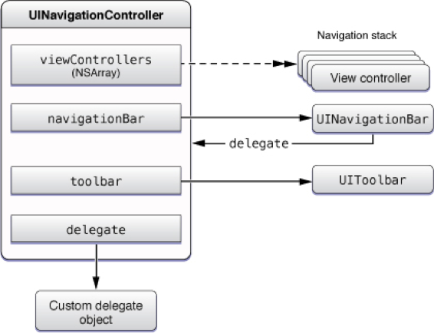
Navigation & Workflows
Figure 2 shows the relationships between the navigation controller and the objects it manages. Use the specified properties of the navigation controller to access these objects.
Figure 2 Objects managed by the navigation controller

Slide 20
Navigation & Workflows
Class
UINavigationBar
Navigational controls displayed in a bar along the top of the screen, usually in conjunction with a navigation controller.
Overview
A UINavigationBar object is a bar, typically displayed at the top of the window, containing buttons for navigating within a hierarchy of screens. The primary components are a left (back) button, a center title, and an optional right button. You can use a navigation bar as a standalone object or in conjunction with a navigation controller object.

Slide 21
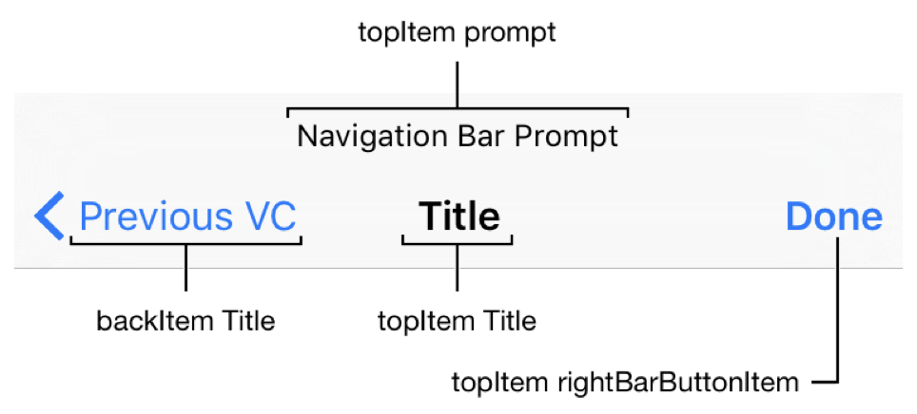
Navigation & Workflows
Figure 1 Navigation bar

Slide 22
Navigation & Workflows
A navigation bar is most commonly used within a navigation controller. The UINavigationController object creates, displays, and manages its associated navigation bar, and uses attributes of the view controllers you add to control the content displayed in the navigation bar.
To control a navigation bar when using a navigation controller, the following steps are required:
Create a navigation controller in Interface Builder or in the code.
Configure the appearance of the navigation bar using the navigationBar property on the UINavigationController object.
Control the content of the navigation bar by setting the title and navigationItem properties on each UIViewController you push onto the navigation controller’s stack.
You can also use a standalone navigation bar, without using a navigation controller. To add a navigation bar to your interface, the following steps are required:
Set up Auto Layout rules to govern the position of the navigation bar in your interface.
Create a root navigation item to supply the initial title.
Configure a delegate object to handle user interactions with the navigation bar.
Customise the appearance of the navigation bar.
Configure your app to push and pop relevant navigation items as the user navigates through the hierarchical screens.

Slide 23
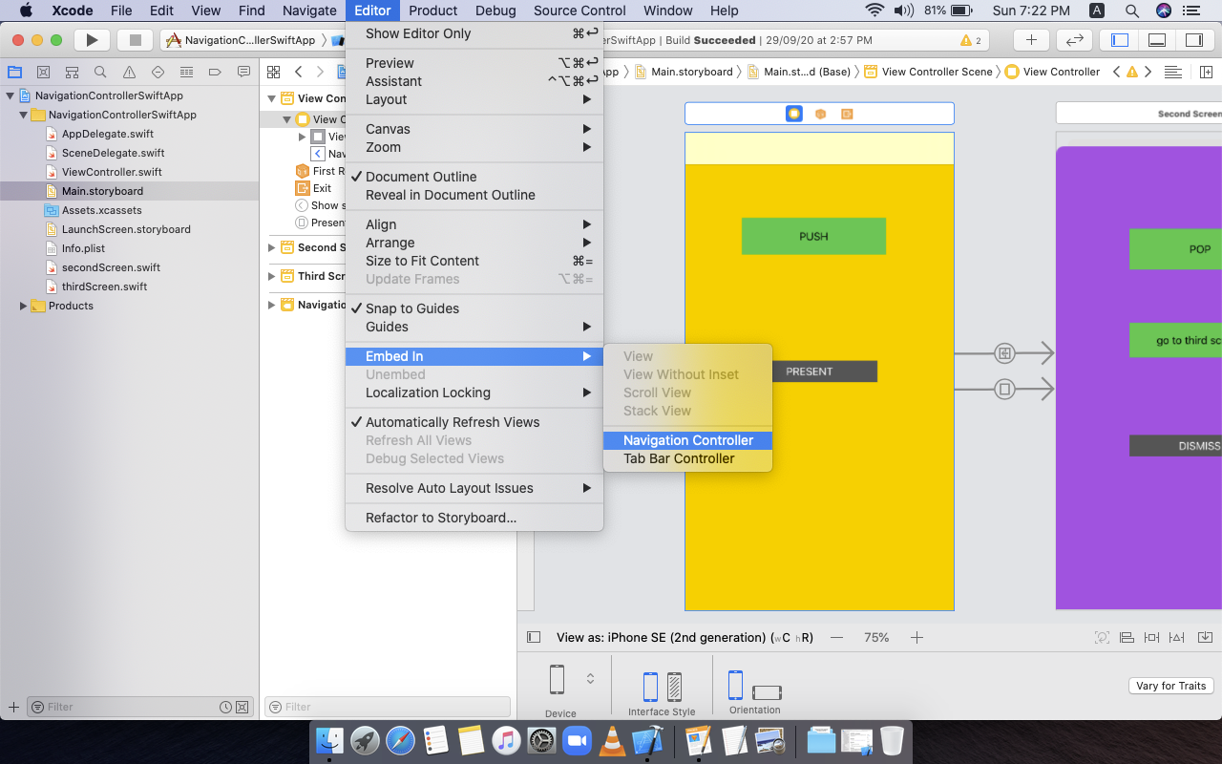
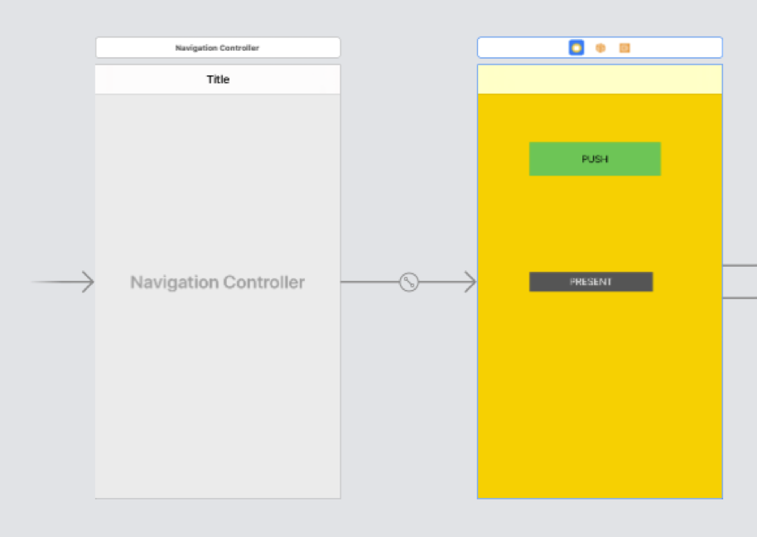
Navigation & Workflows
Steps for how to add a navigationController to a ViewController
Step 1: Open the StoryBoard file, Select RootViewController(starting Screen)
Step 2: In Mac Toolbar Select Editor, Select Embed In, Select NavigationController Option.

Slide 24
Navigation & Workflows
Pushing & Popping Methods
1. Instance Method
pushItem(_:animated:)
Pushes the given navigation item onto the navigation bar's stack and updates the UI.
Declaration
func pushItem(_ item: UINavigationItem, animated: Bool)
Parameters
item
The navigation item to push on the stack.
animated
true if the navigation bar should be animated; otherwise, false.

Slide 25
Navigation & Workflows
2. Instance Method
popItem(animated:)
Pops the top item from the navigation bar's stack and updates the UI.
Declaration
func popViewController(animated: Bool) -> UIViewController?
Parameters
animated
Set this value to true to animate the transition. Pass false if you are setting up a navigation controller before its view is displayed.

Slide 26
Navigation & Workflows
3. Instance Method
present(_:animated:completion:)
Presents a view controller modally.
Declaration
func present(_ viewControllerToPresent: UIViewController, animated flag: Bool, completion: (() -> Void)? = nil)
Parameters
viewControllerToPresent
The view controller to display over the current view controller’s content.
flag
Pass true to animate the presentation; otherwise, pass false.
completion
The block to execute after the presentation finishes. This block has no return value and takes no parameters. You may specify nil for this parameter.

Slide 27
Navigation & Workflows
4. Instance Method
dismiss(animated:completion:)
Dismisses the view controller that was presented modally by the view controller.
Declaration
func dismiss(animated flag: Bool, completion: (() -> Void)? = nil)
Parameters
flag
Pass true to animate the transition.
completion
The block to execute after the view controller is dismissed. This block has no return value and takes no parameters. You may specify nil for this parameter.

Slide 28
Navigation & Workflows
5. Instance Method
popToRootViewController(animated:)
Pops all the view controllers on the stack except the root view controller and updates the display.
Declaration
func popToRootViewController(animated: Bool) -> [UIViewController]?
Parameters
animated
Set this value to true to animate the transition. Pass false if you are setting up a navigation controller before its view is displayed.

Slide 29
Navigation & Workflows
StoryBoard Segue
Class
UIStoryboardSegue
An object that prepares for and performs the visual transition between two view controllers.
Declaration
class UIStoryboardSegue : NSObject
Overview
The UIStoryboardSegue class supports the standard visual transitions available in UIKit. You can also subclass to define custom transitions between the view controllers in your storyboard file. Segue objects contain information about the view controllers involved in a transition. When a segue is triggered, but before the visual transition occurs, the storyboard runtime calls the current view controller’s prepare(for:sender:) method so that it can pass any needed data to the view controller that is about to be displayed.

Slide 30
Navigation & Workflows
You do not create segue objects directly. Instead, the storyboard runtime creates them when it must perform a segue between two view controllers. You can still initiate a segue programmatically using the performSegue(withIdentifier:sender:) method of UIViewController if you want. You might do so to initiate a segue from a source that was added programmatically and therefore not available in Interface Builder.
Subclassing Notes
You can subclass UIStoryboardSegue in situations where you want to provide a custom transition between view controllers in your application. To use your custom segue, create a segue line between the appropriate view controllers in Interface Builder and set its type to Custom in the inspector; you must also specify the class name of the segue to use in the inspector.
When the storyboard runtime detects a custom segue, it creates a new instance of your class, configures it with the view controller objects, asks the view controller source to prepare for the segue, and then performs the segue.

Slide 31
Navigation & Workflows
Methods to Override
For custom segues, the main method you need to override is the perform() method. The storyboard runtime calls this method when it is time to perform the visual transition from the view controller in source to the view controller in destination. If you need to initialize any variables in your custom segue subclass, you can also override the init(identifier:source:destination:) method and initialize them in your custom implementation.
Alternatives to Subclassing
If your segue does not need to store additional information or provide anything other than a perform() method, consider using the init(identifier:source:destination:performHandler:) method instead.

Slide 32
App Anatomy Life Cycle
Navigation & Workflows
An application which is written in iOS Framework have to traverse through multiple states as it runs. These states are known as state’s of application lifecycle.
The current state of your app determines what it can and cannot do at any time.
Example:
A foreground app has the user’s attention, so it has priority over system resources, including the CPU.
By contrast, a background app must do as little work as possible, and preferably nothing, because it is offscreen.
As your app changes from state to state, you must adjust its behavior accordingly.
When your app’s state changes, UIKit notifies you by calling methods of the appropriate delegate object:
In iOS 13 and later, use UISceneDelegate objects to respond to life-cycle events in a scene-based app.
In iOS 12 and earlier, use the UIApplicationDelegate object to respond to life-cycle events.

Slide 33
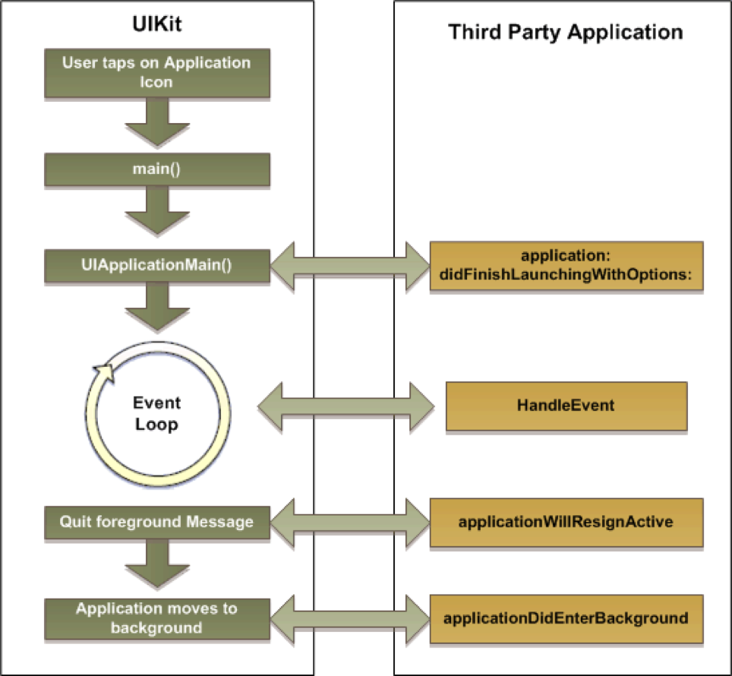
Navigation & Workflows

Slide 34
Navigation & Workflows
When an iOS app is launched the first thing called is
application: willFinishLaunchingWithOptions:-> Bool. This method is intended for initial application setup. Storyboards have already been loaded at this point but state restoration hasn’t occurred yet.
Launch
application: didFinishLaunchingWithOptions: -> Bool is called next. This callback method is called when the application has finished launching and restored state and can do final initialization such as creating UI.
applicationWillEnterForeground: is called after application: didFinishLaunchingWithOptions: or if your app becomes active again after receiving a phone call or other system interruption.
applicationDidBecomeActive: is called after applicationWillEnterForeground: to finish up the transition to the foreground.

Slide 35
Navigation & Workflows
Termination
applicationWillResignActive: is called when the app is about to become inactive (for example, when the phone receives a call or the user hits the Home button).
applicationDidEnterBackground: is called when your app enters a background state after becoming inactive. You have approximately five seconds to run any tasks you need to back things up in case the app gets terminated later or right after that.
applicationWillTerminate: is called when your app is about to be purged from memory. Call any final cleanups here.
Both application: willFinishLaunchingWithOptions: and application: didFinishLaunchingWithOptions: can potentially be launched with options identifying that the app was called to handle a push notification or url or something else. You need to return true if your app can handle the given activity or url.

Slide 36
Navigation & Workflows
Knowing your app’s lifecycle is important to properly initialize and set up your app and objects. You don’t have to run everything in application: didFinishLaunchingWithOptions, which often becomes a kitchen sink of setups and initializations of some sort.
Every iOS application will transitioned into following states:
Not Running
Inactive
Active
Background
Suspended.

Slide 37
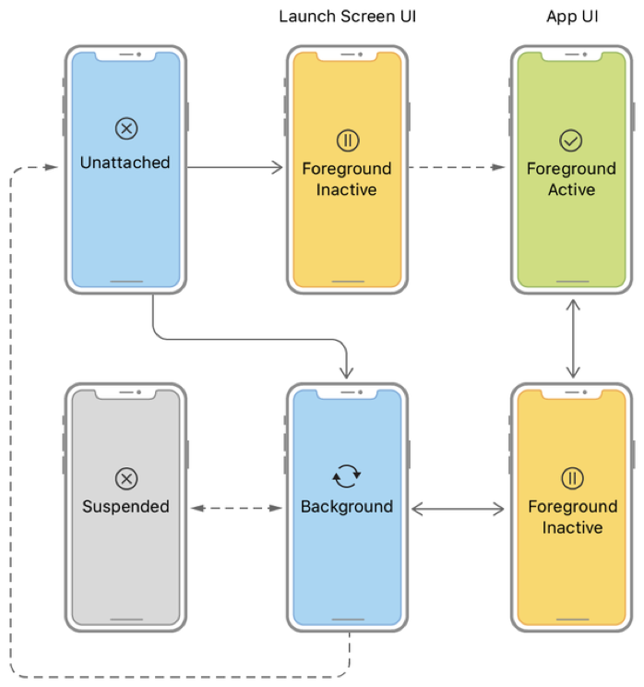
Navigation & Workflows

Slide 38
Navigation & Workflows
Not Running state : The app not started or be stoped.
Inactive state : The app is entering the foreground state, but cannot process event.
Active state: The app enters the foreground state and can process event.
Background state : The app goes into the background, and if there is executable code, it will execute, and if there is no executable code or the execution is complete, the application will be suspended immediately.
Suspended state : The suspended application goes into a frozen state, unable to execute code, and terminate if the system does not have enough memory.

Slide 39
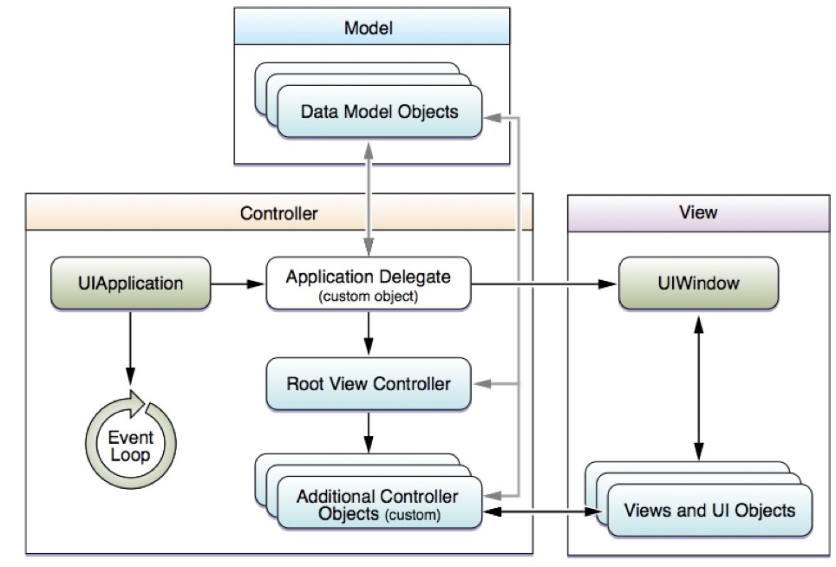
Model View Controller Design Pattern
Navigation & Workflows

Slide 40
Navigation & Workflows
MVC is an integrated Design Pattern
MVC stands for Model View Controller
Model (All Data Related Functionality) :
The model is the brain of the application. It does the calculations and creates a virtual world for itself that can live without the views and controllers. In other words, think of a model as a virtual copy of your application, without a face.
View (All UserInterface Related Functionality) :
A view is the window through which your users interact with your application. It displays what’s inside the model most of the time, but in addition to that, it accepts users’ interactions. Any interaction between the user and your application is sent to a view, which then can be captured by a view controller and sent to the model.

Slide 41
Navigation & Workflows
Controller (Application Functionality) :
Controllers in iOS programming usually refer to view controllers. Think of view controllers as a bridge between the model and your views. They interpret what is happening on one side (what the user does on the view side, or the information provided by the model) and use that information to alter the other side as needed.
Advantages of MVC Design Pattern:
1) Faster development process: MVC supports rapid and parallel development. With MVC, one programmer can work on the view while other can work on the controller to create business logic of the web application. The application developed using MVC can be three times faster than application developed using other development patterns.
2) Ability to provide multiple views: In the MVC Model, you can create multiple views for a model. Code duplication is very limited in MVC because it separates data and business logic from the display.

Slide 42
Navigation & Workflows
3) Support for asynchronous technique: MVC also supports asynchronous technique, which helps developers to develop an application that loads very fast.
4) Modification does not affect the entire model: Modification does not affect the entire model because model part does not depend on the views part. Therefore, any changes in the Model will not affect the entire architecture.
5) MVC model returns the data without formatting: MVC pattern returns data without applying any formatting so the same components can be used and called for use with any interface.
6) SEO friendly Development platform: Using this platform, it is very easy to develop SEO-friendly URLs to generate more visits from a specific application.

Slide 43
TabBar Controller
Navigation & Workflows
Class
UITabBarController
A container view controller that manages a radio-style selection interface, where the selection determines which child view controller to display.
Overview
The tab bar interface displays tabs at the bottom of the window for selecting between the different modes and for displaying the views for that mode. This class is generally used as-is, but may also be subclassed.
Each tab of a tab bar controller interface is associated with a custom view controller. When the user selects a specific tab, the tab bar controller displays the root view of the corresponding view controller, replacing any previous views. (User taps always display the root view of the tab, regardless of which tab was previously selected. This is true even if the tab was already selected.) Because selecting a tab replaces the contents of the interface, the type of interface managed in each tab need not be similar in any way. In fact, tab bar interfaces are commonly used either to present different types of information or to present the same information using a completely different style of interface.

Slide 44
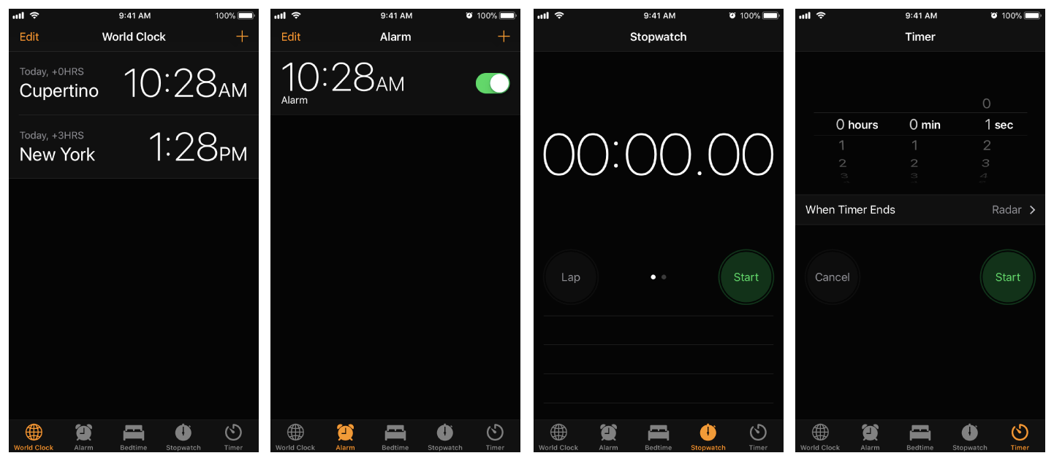
Navigation & Workflows
Figure 1 shows the tab bar interface presented by the Clock app, each tab of which presents a type of time based information.
Figure 1
The tab bar interface in the Clock app

Slide 45
Navigation & Workflows
You should never access the tab bar view of a tab bar controller directly. To configure the tabs of a tab bar controller, you assign the view controllers that provide the root view for each tab to the viewControllers property. The order in which you specify the view controllers determines the order in which they appear in the tab bar. When setting this property, you should also assign a value to the selectedViewController property to indicate which view controller is selected initially. (You can also select view controllers by array index using the selectedIndex property.) When you embed the tab bar controller’s view (obtained using the inherited view property) in your app window, the tab bar controller automatically selects that view controller and displays its contents, resizing them as needed to fit the tab bar interface.
Tab bar items are configured through their corresponding view controller. To associate a tab bar item with a view controller, create a new instance of the UITabBarItem class, configure it appropriately for the view controller, and assign it to the view controller’s tabBarItem property. If you don't provide a custom tab bar item for your view controller, the view controller creates a default item containing no image and the text from the view controller’s title property.
As the user interacts with a tab bar interface, the tab bar controller object sends notifications about the interactions to its delegate. The delegate can be any object you specify but must conform to the UITabBarControllerDelegate protocol. You can use the delegate to prevent specific tab bar items from being selected and to perform additional tasks when tabs are selected. You can also use the delegate to monitor changes to the tab bar that are made by the More navigation controller, which is described in more detail in The More Navigation Controller.

Slide 46
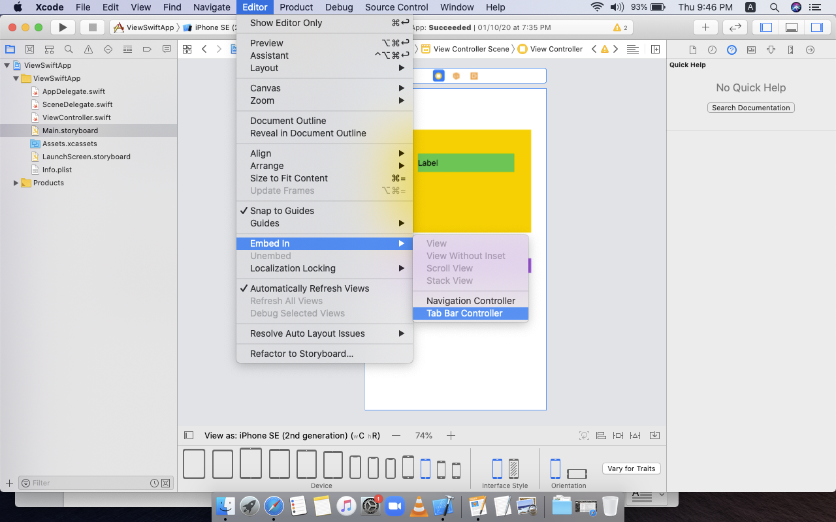
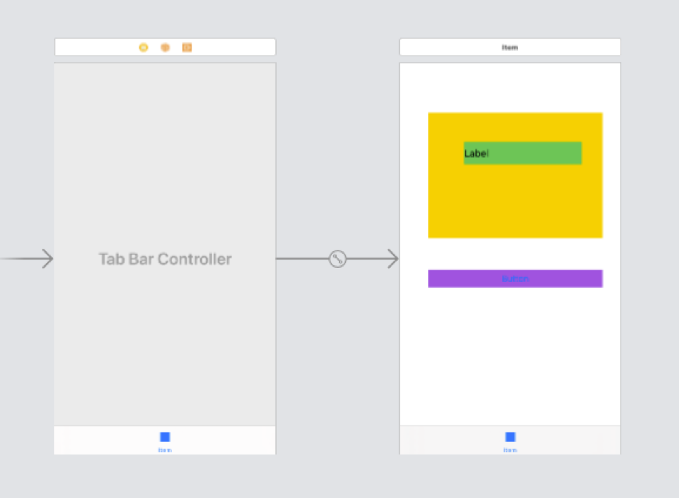
Navigation & Workflows
Steps for how to add a TabBarController to a ViewController
Step 1: Open the StoryBoard file, Select RootViewController(starting Screen)
Step 2: In Mac Toolbar Select Editor, Select Embed In, Select TabBarController Option.

Slide 47
ViewController Life Cycle
Navigation & Workflows
Introduction:
It’s important to understand Apps Life cycle and View Controller life Cycle before start to develop iOS Apps.So today i will discuss View controllers life cycle and few basic of View controller .
What you will learn:
What is View Controller .
Why View Controller important.
How view Controller work .
View controller life cycle.
There is three way to create UI (Which attached with a viewController class ).
From the .xib
From Code
By Storyboard

Slide 48
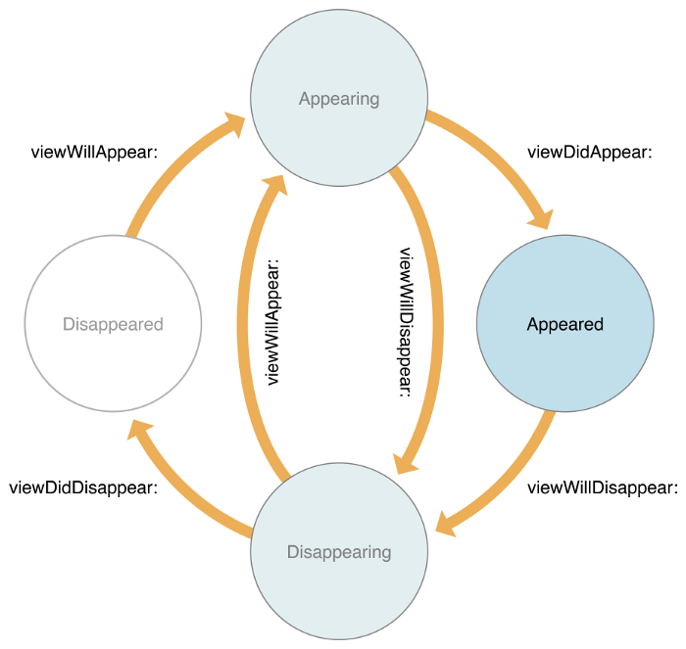
Navigation & Workflows
View controller Life Cycle :

Slide 49
Navigation & Workflows
loadView
This method use when view Controller create from code .Its good not to do anything on this method .If view Controller made from .xib or storyboard.
What Do in View Load : loadView( ) is a method managed by the viewController. The viewController calls it when its current view is nil. loadView( ) basically takes a view (that you create) and sets it to the viewController’s view (superview).
viewDidLoad:
This Method is loaded once in view controller life cycle .Its Called When all the view are loaded .You Can do Some common task in this method :
1.Network call which need Once.
2.User Interface
3.Others Task Those are Need to do Once
viewWillAppear:
This Method is called every time before the view are visible to and before any animation are configured .In this method view has bound but orientation not set yet.You can override this method to perform custom tasks associated with displaying the view such as to hide fields or disable actions before the view becomes visible.
viewWillLayoutSubviews:
It don’t do Nothing by default. When a view’s bounds change, the view adjusts the position of its subviews. View controller can override this method to make changes before the view lays out its subviews.

Slide 50
Navigation & Workflows
viewDidLayoutSubviews:
This method is called after the viewController has been adjust to its subview following a change on its bound.Add code here if you want to make change to subviews after they have been set.
viewDidAppear:
This Method is called after the view present on the screen. Usually save data to core data or start animation or start playing a video or a sound, or to start collecting data from the network This type of task good for this method.
viewWillDisappear:
This method called before the view are remove from the view hierarchy.The View are Still on view hierarchy but not removed yet . any unload animations haven’t been configured yet. Add code here to handle timers, hide the keyboard, cancel network requests, revert any changes to the parent UI. Also, this is an ideal place to save state.

Slide 51
Navigation & Workflows
viewDidDisappear:
This method is called after the VC’s view has been removed from the view hierarchy. Use this method to stop listening for notifications or device sensors.
deinit:
Before a view controller is removed from memory, it gets deinitialized. You usually override deinit() to clean resources that the view controller has allocated that are not freed by ARC. Keep in mind that just because a VC is no longer visible, doesn’t mean that it has been deallocated. Container view controllers such as NavigationController can keep their VCs available in memory. Keep in mind that even though a VC is off screen, if it is still in memory, it still works normally and can receive notifications.
didReceiveMemoryWarning()
When memory starts to fill up, iOS does not automatically move data from memory to its limited hard disk space. It does, however, issue this warning and YOU (I mean YOU) are responsible for clearing some objects out of memory. Be aware that if the memory of your app goes over a certain threshold, iOS will shutdown your app. Unfortunately, this will look like a crash to the end user.
viewWillTransition(to:with:)
When the interface orientation changes, UIKit calls this method on the window’s root view controller before the size changes are about to be made. The root view controller then notifies its child view controllers, propagating the message throughout the view controller hierarchy. The parameter to contains the new CGSize size of the container’s view and the parameter with contains a UIViewControllerTransitionCoordinator coordinator, an enum that describes the new orientation.

Slide 52
Prototyping & Project Planning
Navigation & Workflows
How to Prototype A Mobile App?
In this we will learn creating mobile app blueprints to share six steps for creating a mobile app prototype.
Step 1: Understand The Problem
One of the first steps in creating a quality app is ensuring you have a problem worth solving. The problem could range from a corporate requirement, if you’re going after the B2B market, to something as simple as boredom (see games). You might be thinking that this step sounds pretty straightforward. It is. But you’d be surprised how many people come to us with ideas just because they seemed “cool.”
“Cool” isn’t a reason for building an app. You build an app because you wish you could communicate with your friends more easily. You build an app because you think the dating process is broken. You build an app because you have identified a problem in the world, and it’s your mission to fix that problem.

Slide 53
Navigation & Workflows
When we work with clients, we always take them through a process that allows us to uncover the purpose of the app. We look to better understand the industry as a whole, the competition, business goals, audience goals and dive deep into understanding the features of the app that truly matter to their audience. Once we have clearly identified the audience and the pain that this app solves, we begin to design the user’s journey between pain and solution.
All of this takes time. It’s one of most frequently overlooked steps in the process and as a result, we see millions of apps in the App Store graveyard.

Slide 54
Navigation & Workflows
Step 2: Identify Key Functionality Requirements
Once you’ve identified the problem, start brainstorming product requirements. It’s easy—and quite fun—to list the hundreds of different features your app should have. And that’s exactly what you should do!
Before you build your iOS app or Android app, create a list of the features that would make up your ideal app. From there, prioritize those items by what is the most important to your target audience versus what would be nice to have.
Here’s an example of what such a list might look like for Instagram users:
1) Photo Capture
2) Photo Feed
3) Social Accounts
4) Photo Filters
5) Comments + Likes
6) Search Functionality
7) Private Accounts
8) Account Discovery
9) Online Advertising
10) Video Stories

Slide 55
Navigation & Workflows
Today, Instagram places all these features at your fingertips. But when the app first launched, it was much simpler and contained the minimum feature set necessary for testing the idea. As the app gained traction, Instagram began to tackle the rest of their feature wish list and over the years has expanded the app’s functionality.
Take the first 3–4 features on your priority list and design your app for those. You can add other features once you demonstrate that you have an idea that resonates and your app is something people actually want.

Slide 56
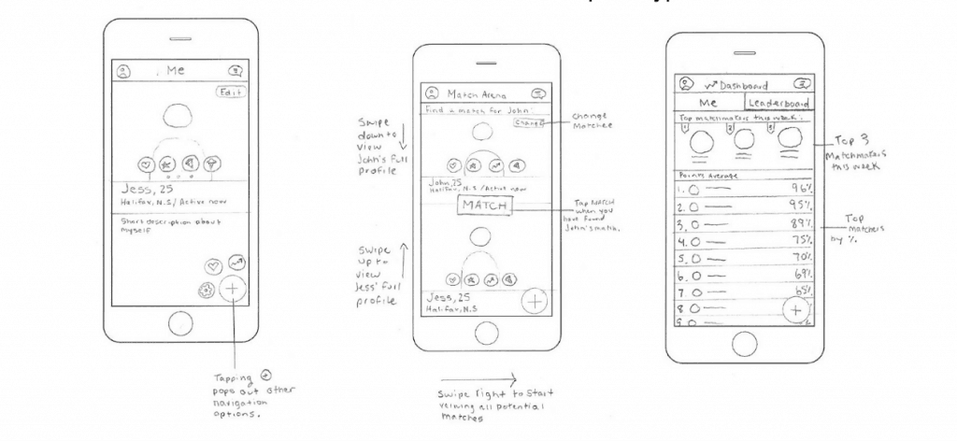
Navigation & Workflows
Step 3: Create Sketches Of The Primary Screens
After you figure out the highest priority features, start thinking through the user experience. One of the best ways to craft the user experience is to begin with a few rough sketches of how the primary screens should look and feel. Take a look at these sketches we did for the Glue prototype:
We organized the app into three main screen functionalities: profiles, matches and the dashboard. Once we had these sketches, we were able to build out the screens we envisioned in more detail.

Slide 57
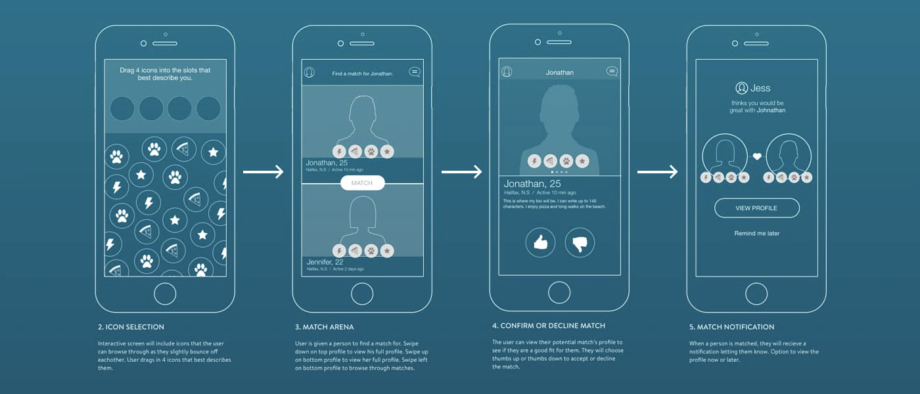
Navigation & Workflows
Step 4: Turn Your Sketches Into Wireframes
Once you have sketched your primary screens, you can start wireframing.
A wireframe is a low-fidelity, simplified outline of your product consisting of boxes, words, lines and sometimes descriptions. It’s meant to lay the framework of where your app will go rather than the final look and feel of the app.

Slide 58
Navigation & Workflows
Step 5: Turn Wireframes Into A Prototype
Wireframes that can be put in the hands of people who might want to test your product are great for feedback. You can turn low-fidelity wireframes to a basic prototype and share it with your target audience, friends, peers, manager and boss to help them understand and give feedback on the app.
We’ve used a number of mobile prototyping tools over the years to move from initial concept to interactive prototype. InvisionApp is one of the most commonly used prototyping tools and is very accessible for basic prototypes. Most recently, Xcode has become our go-to for bringing wireframes to life. It is more complex, but also a much more powerful tool than Invision. With Xcode you can build a prototype that looks and feels just like a real app using fake data and placeholder content.
Prototyping not only makes your product more real for investors, but it also gives your testers the ability to get a real feel for what it would be like to use the app, and arms your developers with a better sense of the intended UX before finalizing the design.

Slide 59
Navigation & Workflows
Step 6: Translate Wireframes Into Final Designs
Finally, it’s time to transition from grey wireframes to pixel perfect designs. If you don’t have the skills to implement the design yourself, you can find a co-founder, hire an app agency, or bring in a freelancer.
In each scenario, you will want to spend time talking to these people about your vision and gauge their ability to execute by reviewing their past work. Some designers use Sketch to create their app designs; others use Illustrator. When you have the final files, update your Invision or Xcode prototype to make it look and feel like it’s live.

Slide 60
Navigation & Workflows
Sharing Your Prototype With Investors
After all that hard work, you have to be ready for the big presentation.
Landing a meeting with an investor is the first step. As Andreessen says, the best way to land an investor meeting is through a referral. If you don’t have a referral, reaching out to an investor through a cold email is one of your better options. Elizabeth Yin of 500 Startups, a venture capital fund, offers 7 tips for sending cold emails to investors:
1) Keep your email short
2) Use bullet points to highlight the best parts of your company
3) Make the email scannable
4) Don’t attach a deck in the first email
5) Use an email tracker
6) Your call to action is to land a meeting
7) Don’t be afraid to follow up
Once you land a meeting, you should come prepared with a few key things:
A clear story surrounding your app and why it’s a great investment
A pitch deck that shows the problem, solution and business model
A short one-pager that can act as a leave-behind for investors
Your prototype so you can walk the investors through the app
It’s important to be transparent about whether your prototype is or isn’t an actual, functioning product. You can share the link to your prototype before the meeting, but it’s often better to walk potential investors through the prototype during the meeting or call and then share the link afterward.

Slide 61
Navigation & Workflows
Assignment
Develop an app using Navigation Controller
Develop an app to transfer data between View Controllers Using Segues

Slide 62
Navigation & Workflows
Document Links
Topics | URL | Notes
Swift Pragramming Language | https://swift.org/ | Give the information to learn Swift Programming Language
Navigation & workflow Concepts | https://developer.apple.com/documentation/ | Navigation & workflow Concepts

Slide 63
Navigation & Workflows
E-Book Links
https://swift.org/
https://developer.apple.com/documentation/

